Slide 1

SMART SPEED BREAKER WITH ZEBRA CROSSING
IoT Project
Jayadarshini v (210701088)
Harish Rajan S (210701076)
Joshita Umanath (210701098)

Slide 2
ABSTRACT
This project introduces a novel approach to road safety by integrating intelligent technologies into speed breakers and zebra crossings. The Smart Breaker system utilizes speed sensing technology to dynamically adjust the speed breaker based on the approaching vehicle's speed. When vehicles exceed a predefined speed threshold, the speed breaker automatically elevates to effectively slow down the traffic. Furthermore, the system incorporates an advanced zebra crossing with embedded LED lights that illuminate when pedestrians stand on the crossing, enhancing their visibility to approaching vehicles. This feature significantly improves pedestrian safety, especially during low light conditions or high traffic volumes.

Slide 3
INTRODUCTION
A smart speed breaker integrated with a smart zebra crossing aims to create a safer and more efficient traffic environment.
Raising the speed breaker only when a pedestrian is crossing, prioritizes pedestrian safety while reducing unnecessary slowdowns for law-abiding drivers.
This system also gathers data on pedestrian activity and traffic patterns, allowing for smarter traffic management and congestion reduction. Ultimately, this integration contributes to a more technologically advanced city infrastructure with a focus on both safety and efficiency.

Slide 4
LITERATURE SURVEY
In [1] paper explains about poor visibility conditions during foggy winters or nighttime driving as leading causes of road accidents in India. The primary contributor to such accidents is often attributed to drivers' unintentional oversight of speed breakers, either due to their inability to detect them promptly or due to vehicles traveling at excessive speeds.
This paper[2] introduces a novel approach to enhancing public safety through the implementation of a flexible speed breaker system. The primary objective of this project is to mitigate road accidents by regulating vehicle speeds, particularly when vehicles surpass their speed limits.

Slide 5
PROPOSED SYSTEM
This project proposes a more modern and potentially more affordable approach to speed monitoring:
Hardware: It utilizes an Arduino for processing and an array of sensors (ultrasonic sensors, servo motor) for data collection and potential speed control.
Software: The code written in Arduino C++ language controls the hardware components and performs calculations.
Data Connectivity: The system integrates WiFi for uploading data to ThingSpeak, allowing for remote monitoring and analysis.

Slide 6
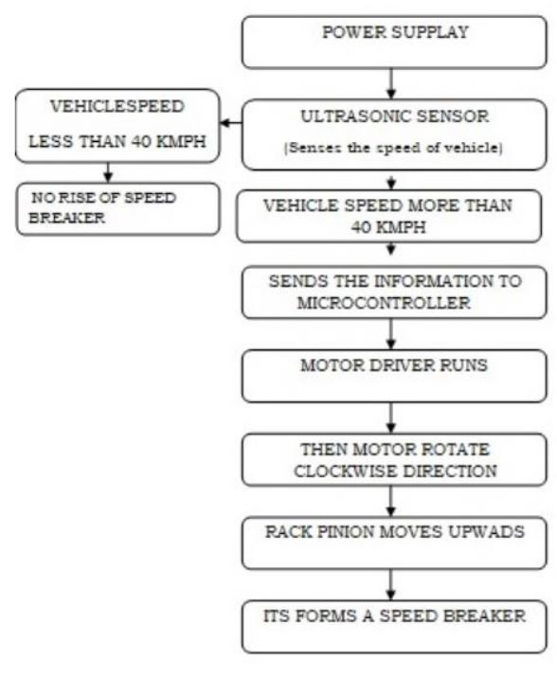
SYSTEM ARCHITECTURE

Slide 7
METHODOLOGY
Arduino Uno: This is serves as the central control unit for the project.
IR Sensor Module: The IR (Infrared) sensor module is used for detecting the speed of approaching vehicles.
RF Module: The RF (Radio Frequency) module enables wireless communication between the speed breaker system and vehicles
Servo Motor: The servo motor is responsible for adjusting the height of the speed breaker based on the detected vehicle speed.

Slide 8
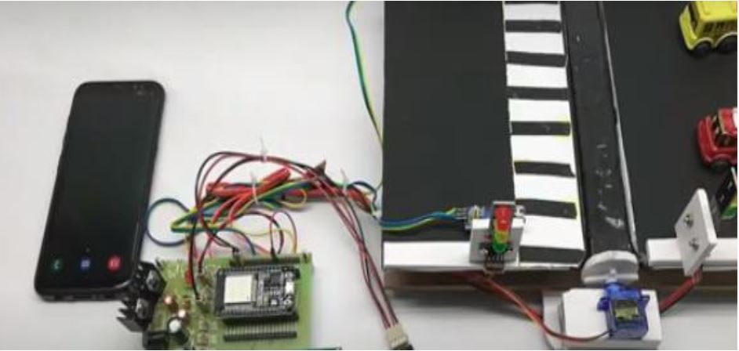
RESULT

Slide 9
CONCLUSION
In conclusion, the smart speed breaker system presents a significant advancement in road safety technology by effectively addressing the challenges posed by speeding vehicles and poor visibility conditions. While the current implementation demonstrates promising results in regulating vehicle speeds and enhancing driver awareness, further enhancements can be explored to maximize its effectiveness. These include integrating machine learning algorithms for predictive analysis, enhancing communication capabilities, adapting to environmental factors, implementing data analytics for informed decision-making, and integrating with existing smart city infrastructure.

Slide 10
REFERENCES
Fan X.H., Zhang Y.L. A Design of bi-verification vehicle access intelligent control system based on RFID. Proceedings of the Ninth
International Conference on Electronic Measurement & Instruments (ICEMI’2009); Beijing, China. August 16–19, 2009.
Patel, H. K., Dutta, S. K., & Das, P. S. (2015). Production of Electricity by the Method of Road Power. International Journal of Research (IJR)

